Slide 1
East-Asian Restaurants in Manhattan
Xihua Jiang
August 23, 2020

Slide 2
Introduction
This report is targeted to residents in, and tourists to, Manhattan who are interested in Japanese, Chinese and Korean food.
This report should also be helpful to stakeholders interested in opening an east-Asian restaurant in Manhattan.

Slide 3
Data
A dataset that contains the Manhattan neighborhoods as well as their latitude and longitude coordinates of each. Here is the link to the dataset: https://geo.nyu.edu/catalog/nyu_2451_34572
Number, type and location of restaurants in every neighborhood will be obtained using Foursquare API

Slide 4
Restaurants in Manhattan
The top 10 popular restaurants in Manhattan are Italian (239), American (132), Mexican (109), Chinese (104), Sushi (87), French (73), Japanese (72), Seafood (52), Mediterranean (50) and Indian (48).
The most popular restaurants for all neighborhoods are mainly Italian, American, Mexican, Chinese and Japanese.

Slide 5
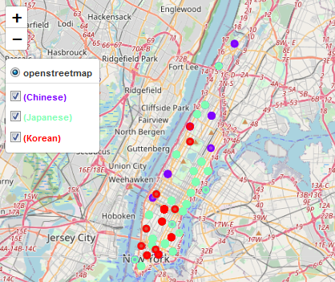
East-Asian Restaurants
There are 196 Japanese, 128 Chinese and 44 Korean restaurants in Manhattan
The top 8 neighborhoods for east-Asian restaurants are as follows:
Neighborhood | # of Restaurants
Midtown South | 37
Chinatown | 35
East Village | 20
Noho | 17
Flatiron | 16
Greenwich Village | 15
Little Italy | 15
Midtown | 14

Slide 6
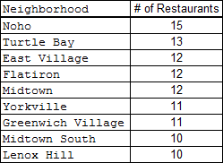
Japanese Restaurants
39 out of 40 neighborhoods in Manhattan have Japanese restaurants!
Top 6 neighborhoods with Japanese restaurants:

Slide 7
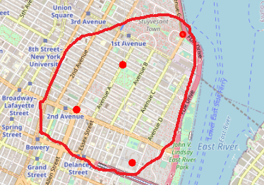
Cluster of Japanese Restaurants
East Village, Lower East Side, Noho, and Stuyvesant Town are the neighborhoods concentrated with 32 Japanese restaurants

Slide 8
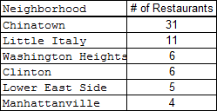
Chinese Restaurants
Chinatown has the most Chinese restaurants (37) among all neighbor hoods. Little Italy also has 11 Chinese restaurants.

Slide 9
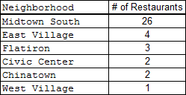
Korean Restaurants
Among all 44 Korean restaurants, 26 of them are in Midtown South.

Slide 10
Discussion
196 Japanese restaurants, 128 Chinese restaurants and 44 Korean restaurants in Manhattan.
Japanese restaurants are the most popular Asian restaurants in Manhattan. Among 40 neighborhoods, 39 of them have Japanese restaurants!
Japanese restaurants are pretty evenly located, so for Manhattan residents and tourists interested in Japanese food, no matter wherever you go, you can always find a Japanese restaurant.
Chinese restaurants exists in 36 out of 40 neighborhoods in Manhattan, but are very concentrated in two neighborhoods - Chinatown and Little Italy. So for Manhattan residents and tourists who love Chinese food, Chinatown and Little Italy are definitely what they should first explore.
Korean restaurants are even more concentrated in and 26 out of 44 Korean restaurants are in Midtown South. So for Korean food lovers, Midtown South is definitely the one-stop neighborhood to visit.

Slide 11
Discussion - continued
For stakeholders interested in opening a Japanese restaurant, maybe East Village, Lower East Side and Noho should be avoided.
As for opening a Chinese restaurant, Chinatown and Little Italy are definitely over-crowded. Other locations might be better candidates.
For those interested in opening a Korean restaurant, Midtown South is definitely the neighborhood to avoid because of its high concentration of Korean restaurants.
Additional factors like customer flow, attractiveness of location, real estate availability, prices, social and economic dynamics of every neighborhood might have more weights on the final decision.

Slide 12
Conclusion
Specific characteristics for east-Asian restaurants:
  Japanese: Even distribution among almost all neighborhoods with a concentration near East Village, Lower East Side, and Noho)
  Chinese: Available in most neighborhoods but fairly concentrated in two of them (Chinatown & Little Italy)
  Korean: Pretty scarce but with one neighborhood of high concentration (Midtown South).
For those who are interested in opening an east-Asian restaurant in Manhattan:
  Final decisions should also be based on other factors such as customer flow, attractiveness of location, real estate availability, prices, social and economic dynamics of every neighborhood etc.

